Slide 1

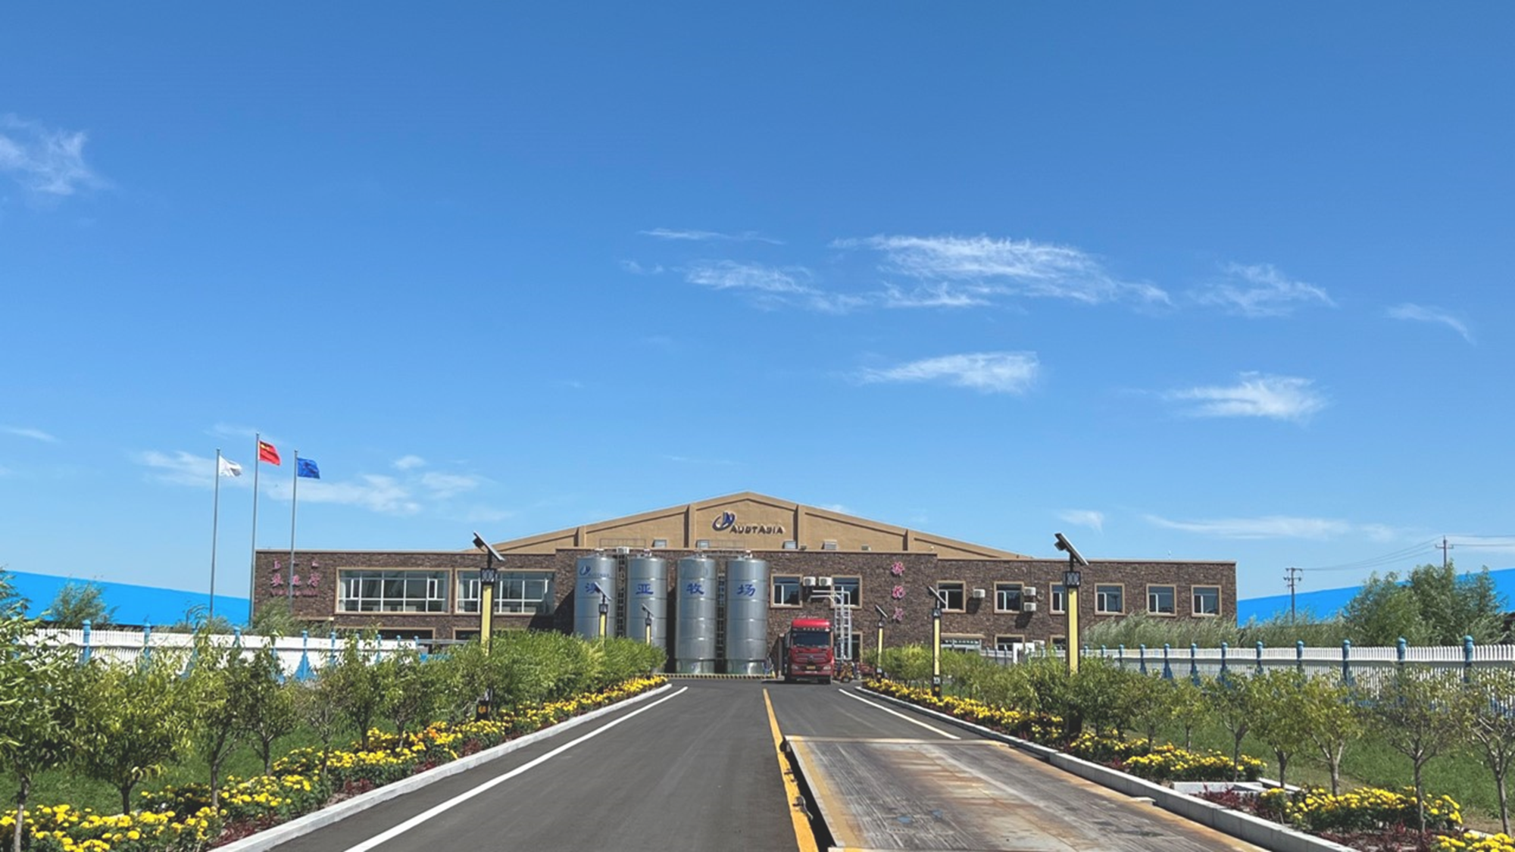
让每一次怀孕变得更有意义
Make Every Pregnancy More Meaningful
梅 承
2025.6. 济南

Slide 2
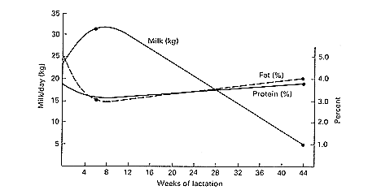
每一次怀孕都有意义
Every pregnancy is meaningful
高效繁殖，空怀天数缩短，平均泌乳天数降低，奶产量上升
Higher reproduction efficiency, less days open, lower DIM, and higher milk production
高效繁殖使得牛群体况、繁殖、健康等一致性更好
Higher reproduction efficiency improve herd consistency of BCS, reproduction and health
提高繁殖效率，尽快进入下一个泌乳胎次
Improve the reproduction efficiency, push cows to the next lactation as soon as possible
收支平衡点 BEP
Notes:
The first step in a cow’s response to lower energy levels is to cut back on reproduction. Remember the imperatives. Reproduction is the lowest priority in energy partitioning. She will shut down her reproduction until she decides that there is enough feed to keep herself alive and take care of her current calf. From a biology point of view, this makes sense. From a dairying point of view, this is not good. When we delay breeding, we delay a return to a high production period of life and ensure that the cow will spend an extended period of time in a low milk part of her life.
The second response to low energy is to lower milk production. She wants to keep the calf alive, but wants to ensure her longevity also. Her production goal is then to produce just enough milk to keep the calf growing until it is old and mature enough to start foraging for its own source of food. The end result is a lower peak and lower production for her entire lactation.
The combination of these two factors yields a cow that is going to be in a period of low production for an extended period of time with lower than average production. The end result is the same as in a beef herd, a disaster that can extend for several years due to low production, slower reproduction and a smaller replacement crop.

Slide 3
澳亚1-7场21天怀孕率汇总
AustAsia Farm 1-7 21 PR summary
Notes:
CI = Calving Interval

Slide 4
澳亚1-7场平均空怀天数汇总
AustAsia Farm 1-7 average DO summary
Notes:
CI = Calving Interval

Slide 5
澳亚1-7场平均泌乳天数汇总
AustAsia Farm 1-7 average DIM summary
Notes:
CI = Calving Interval

Slide 6
澳亚1-7场平均泌乳牛日单产汇总
AustAsia Farm 1-7 average ADM summary
Notes:
CI = Calving Interval

Slide 7
澳亚1-7场干奶时平均泌乳天数汇总
AustAsia Farm 1-7 average DIM when dry off
Notes:
CI = Calving Interval

Slide 8
澳亚1-7场酮病发病率汇总
AustAsia Farm 1-7 fresh cow KET morbidity summary
Notes:
CI = Calving Interval

Slide 9
澳亚1-7场60天内死淘牛比例汇总
AustAsia Farm 1-7 first 60 days culling and death %
Notes:
CI = Calving Interval

Slide 10
澳亚1-7场DIM130天怀孕牛比例汇总
AustAsia Farm 1-7 % of pregnancies within 130 DIM
Notes:
CI = Calving Interval

Slide 11
首次配种CR
更高
Higher CR of the first service
21天怀孕率
提高
Higher 21 PR
开配前体况
损失减少
Less body condition loss
平均空怀天数缩短
Less average DO
繁殖效率驱动牧场效益
Reproduction efficiency drives farm’s profits
新产牛DMI
恢复更快
Increase DMI quicker
平均泌乳天数缩短
Lower DIM
产后代谢病
减少
Less metabolic diseases
泌乳牛奶产量增加
Higher milk production
干奶时体况下降一致性更好
Better BCS when dry-off

Slide 12
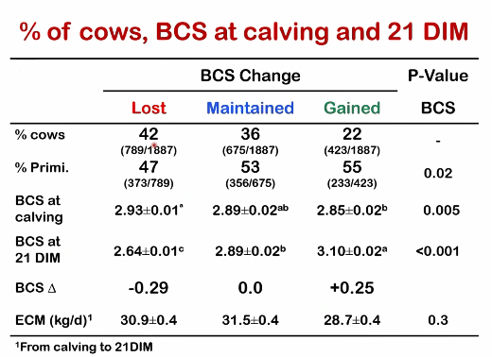
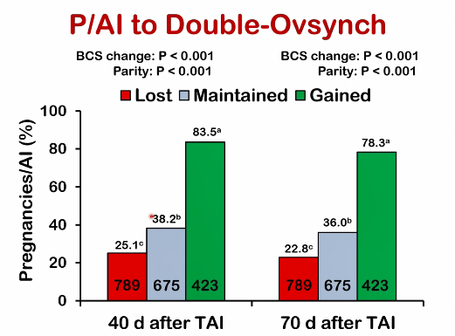
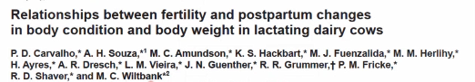
产犊后体况变化对首配受胎率的影响
Effects of BCS change after calving on the first service CR

Slide 13
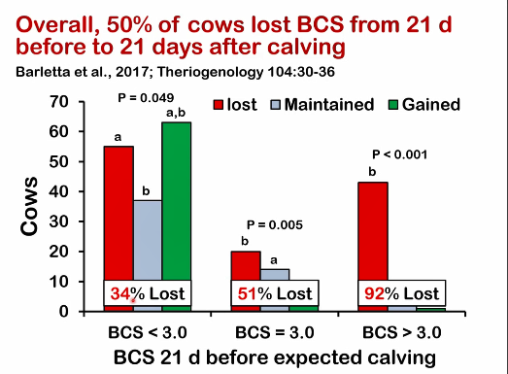
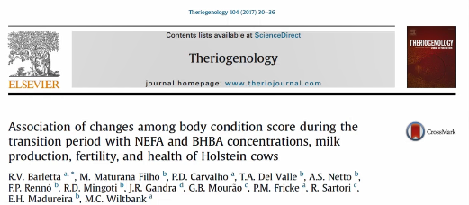
如何让奶牛在产后保持/增加体况
How to maintain/gain the BCS after calving
控制体况，减少产犊时体况评分3.0以上牛的比例
Control the body condition, reduce the proportion of cows with BCS>3 at calving

Slide 14
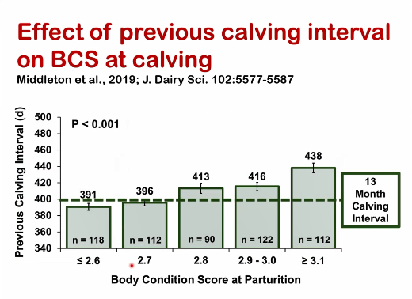
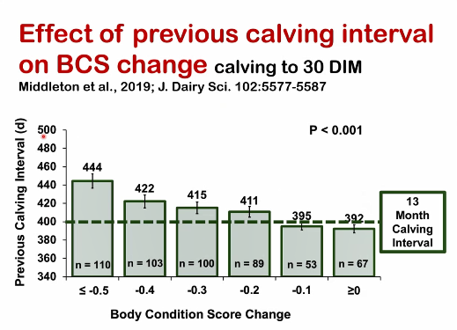
如何减少产犊时体况高分牛的比例
How to reduce the proportion of over-condition cows at calving

Slide 15
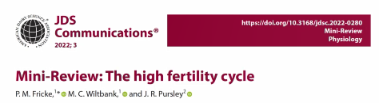
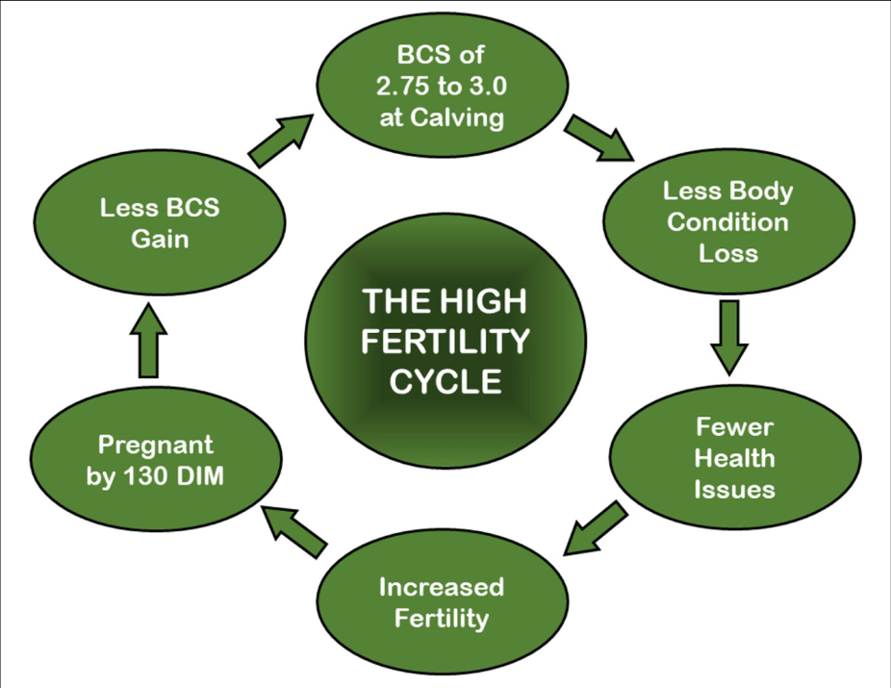
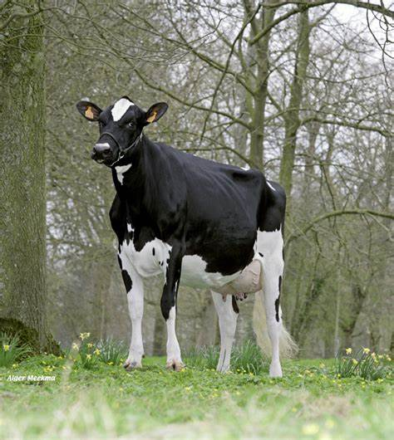
我们又回到了提高繁殖效率
We go back to the improving of reproduction efficiency

Slide 16
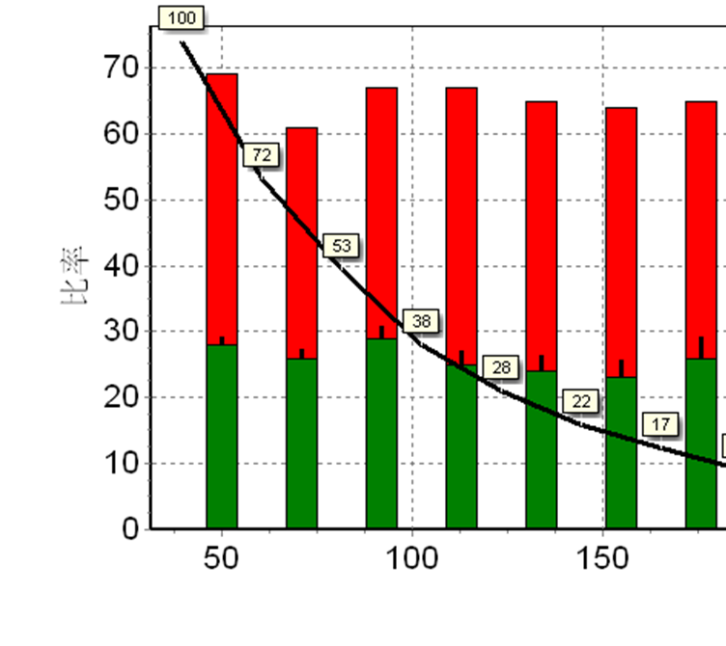
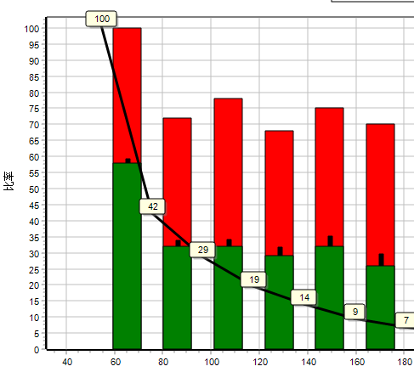
双同期首次配种是扳机
Double Ovysynch is a trigger to improve the reproduction efficiency
首次配种预同期程序
First service with cherry-pick Pre-synch
首次配种预同期程序
First service with double ovysynch
CFAA

Slide 17
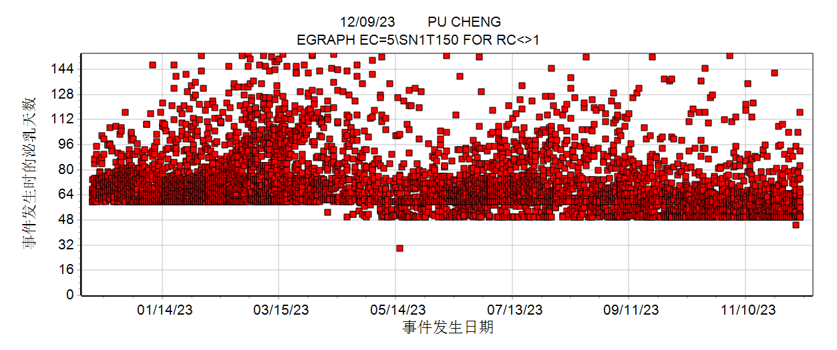
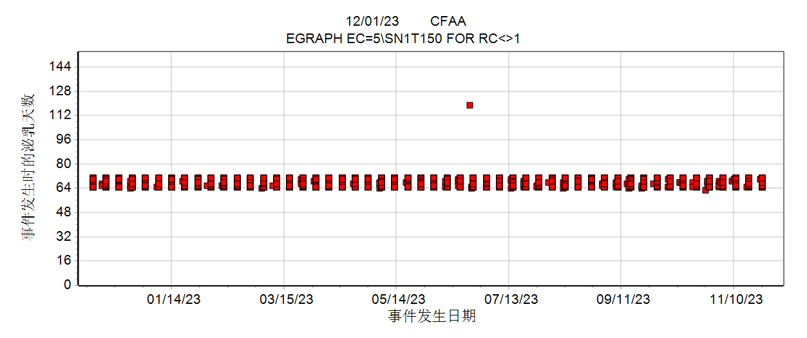
主动停配期之后的参配速度
Insemination rate after VWP

Slide 18
让每一次的怀孕更有意义
Make every pregnancy more meaningful
怀孕带给牧场的不只是…
Pregnancy brings farm…
还包括…
But also including…
更多的后备牛
More heifers
更高的奶产量
Higher milk production
更一致的生产状态
Better herd consistency
更多的选配方案
More mating choices
更快的遗传改良
Faster genetic improvement
更多的经济收益
Higher profits

Slide 19
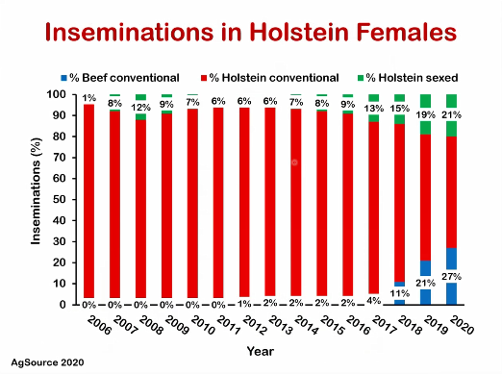
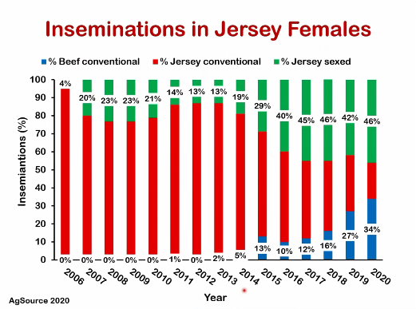
更多选配方案创造更多附加值
More mating options create more added value

Slide 20
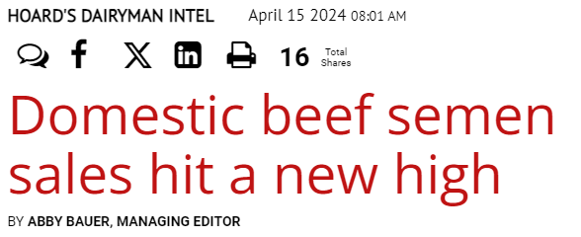
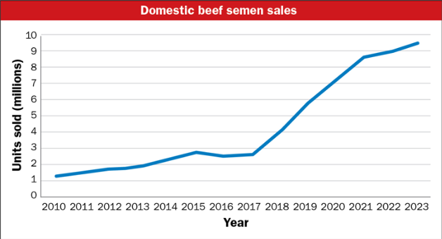
更多的肉牛和性控冻精用于奶牛
More beef and sexed semen are used on dairy
2023年美国国内肉牛冻精销售超过940万剂
9.4 million units of beef semen sold domestically in 2023
其中790万剂用在了奶牛群体
7.9 million units were used in dairy herds
相比于2022年又增加了100万剂
Increased 1 million units from 2022
同时美国国内奶牛冻精的销售量下降了4%
4% decline in domestic dairy semen sales
奶牛性控冻精的销售2023年增长了51.8万剂，达到840万剂
Sexed semen was up by 518,000 units to 8.4 million in 2023
性控冻精占到奶牛冻精销售的54%
Sexed semen represents 54% of the dairy semen used in dairy

Slide 21
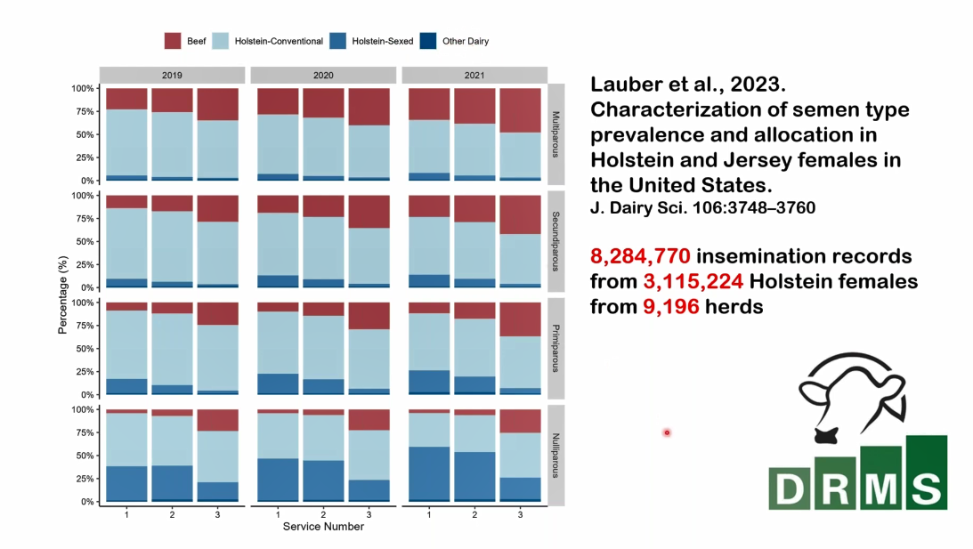

Slide 22
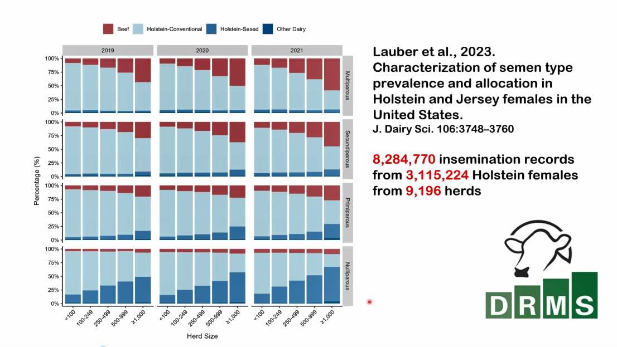

Slide 23
澳亚奶牛群体选配方案
AustAsia dairy herd mating strategy
后30%成母牛选配肉牛冻精
About 30% of bottom cows bred with beef semen
后50%头胎牛首次配种采用胚胎移植
The bottom 50% of 1st lactation cows transferred embryos
后50%青年牛前两次配种采用体外胚胎
Half of the heifers transferred embryos in the first two services
前50%青年牛前两次配种使用性控冻精
Another half of the heifers used sexed semen for the first two services

Slide 24
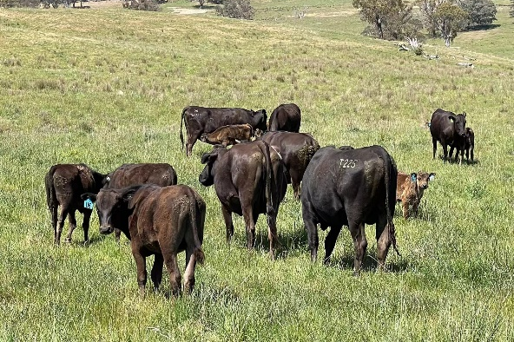
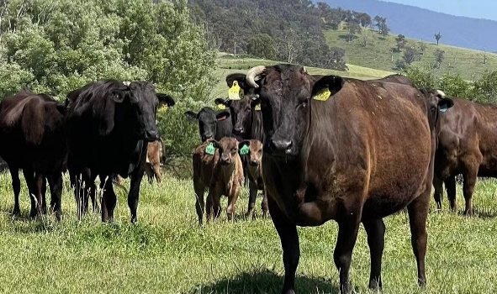
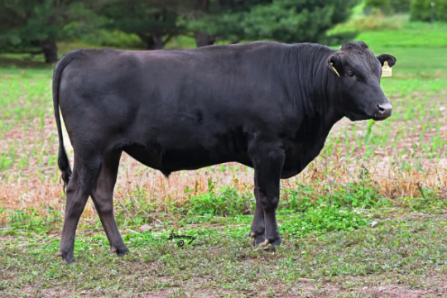
我们的和牛供体
The Wagyu donors we are using
母牛 Donor heifers
澳大利亚和牛协会注册，基因组检测
AWA registered and genomic tested
雪花评分平均值1.2，最高值2.9
The average MS is 1.2 and the highest one is 2.9
眼肉面积平均值3.4，最高值9.8
The average EMA is 2.4 and the highest one is 9.8
公牛 Donor bulls
引进澳大利亚种公牛 Imported from Australia
雪花评分 ≥ 2.5 MS ≥ 2.5
眼肌面积 ≥ 4.0 EMA ≥ 4.0

Slide 25
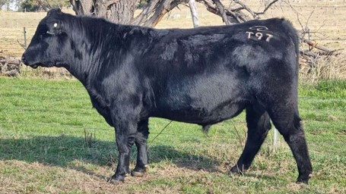
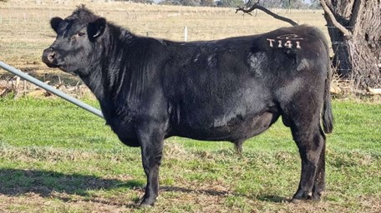
澳亚的安格斯供体
The Angus donors we are using
母牛 Donor heifers
澳大利亚和牛协会注册，基因组检测
AAA registered and genomic tested
肌间脂肪平均值3.3，最高值5.9
The average IMF is 3.3 and the highest one is 5.9
眼肉面积平均值7.4，最高值18.4
The average EMA is 7.4 and the highest one is 18.4
公牛 Donor bulls
引进澳大利亚种公牛 Imported from Australia
TIPTOP T97：IMF6.1 排名前1%；EMA9.2
TOOLSHED T141：IMF6.6 排名前1%；EMA8.2

Slide 26
更快的遗传进展-高品质核心群
Faster genetic progress high-value core herd
CDCB注册NM800母牛数前10名国家
Top 10 NM800 Holstein females registered countries
CDCB 2025年3月3日前出生母牛
CDCB top animal list, female born before 20250303
全球NM值800以上的荷斯坦牛头数43686头
Totally have 43686 Holsteins NM over 800
其中中国注册的牛头数844头
844 from China registration
澳亚有414头，占比49.05%
AustAsia has 414, about 49.04%
注册国家 Country | 头数 # | 占比 %
HOUSA | 39258 | 89.86%
HOBRA | 933 | 2.14%
HOCHN | 844 | 1.93%
HOJPN | 695 | 1.59%
HOCAN | 599 | 1.37%
HOGBR | 394 | 0.90%
HOITA | 157 | 0.36%
HONLD | 126 | 0.29%
HOESP | 118 | 0.27%
HOARG | 112 | 0.26%

Slide 27
更快的遗传进展-高品质核心群
Faster genetic progress to build a high-value core herd
澳亚基因组NM$和TPI前十名母牛 AustAsia top 10 Holstein heifers on NM & TPI
SN | Reg. ID | Birth Date | NM$
1 | HOCHN02PS10244122 | 2024/9/12 | 1061
2 | HOCHNDXAA03253187 | 2025/2/7 | 1047
3 | HOCHNDYAA01249186 | 2024/8/29 | 1022
4 | HOCHN03PS11259041 | 2025/1/27 | 1018
5 | HOCHNCFAA06258801 | 2025/1/22 | 1016
5 | HOCHNTAAA02254032 | 2025/1/29 | 1016
6 | HOCHNXHAA05258016 | 2025/1/28 | 1014
7 | HOCHNDXAA03257013 | 2025/1/6 | 1010
8 | HOCHNXHAA05240303 | 2024/10/26 | 1007
9 | HOCHNXHAA05240237 | 2024/8/22 | 1003
SN | Reg. ID | Birth Date | TPI
1 | HOCHNTAAA02254032 | 2025/1/29 | 3325
2 | HOCHNDXAA03247947 | 2024/12/23 | 3321
3 | HOCHNTXAA08244430 | 2024/8/26 | 3313
4 | HOCHNTAAA02230432 | 2023/2/27 | 3306
5 | HOCHNDYAA01259011 | 2025/2/2 | 3305
6 | HOCHNCAAA07254145 | 2025/3/5 | 3301
7 | HOCHNCAAA07254063 | 2025/1/24 | 3300
7 | HOCHNXHAA05240272 | 2024/9/27 | 3300
7 | HOCHN02PS10244122 | 2024/9/12 | 3300
8 | HOCHNDXAA03257048 | 2025/1/28 | 3298
2025年4月后测结果 2025 April proof

Slide 28
更快的遗传进展-胚胎移植后代
Better genetics improvement – ET offspring
DPR
牛只数量： 410 646 1284 3871 4300
2025 April Proof Results

Slide 29
更快的遗传进展-体外胚胎供体牛
Better genetics improvement – Donors for IVP embryos
DPR
牛只数量： 229 454 652 444 227
2025 April Proof Results

Slide 30
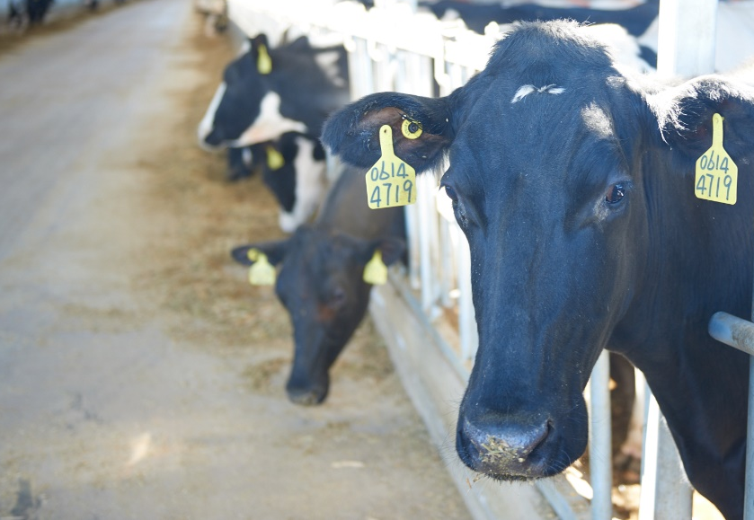
澳亚牧场奶牛群体育种方向
Breeding goals for Austasia Holstein herd
更高产量
Higher milk production
乳成份稳定
Stable milk components
更多怀孕
More pregnancy
更多胎次
More lactations
健康乳房和肢蹄
Health udder and feet leg
更少代谢疾病
Less metabolic diseases
更高饲料效率
Better feed efficiency
更一致的群体
Consistent size and type

Slide 31
体外胚胎移植更快的改良群体
IVF embryo transfer accelerates the herd improvement
 | 2022 | 2023 | 2024
移植头数 Transferred No. | 9014 | 14302 | 19427
受体牛利用率, % Recipients used | 89.41 | 90.92 | 89.27
怀孕头数 Pregnant No. | 4981 | 7460 | 10020
受胎率, % Conception Rate | 55.26 | 52.16 | 51.58
复检怀孕数 Recheck pregnancy | 4442 | 6618 | 8531
复检受胎率, % CR after recheck | 49.28 | 46.27 | 43.91
产犊数 Calving No. | 3974 | 5583
最终产犊率, % Final Calving rate | 44.09 | 39.04

Slide 32
体外胚胎移植和基因组检测是加速器
IVF and genomics are genetic accelerators
选择准确性×选择强度×遗传变异性
遗传进展 =
世代间隔
提高选择准确性：基因组检测、提高系谱准确率、提高选配执行率
Accuracy: genomics, pedigree accuracy, mating compliance
提高选择强度：选种选配、OPU-IVF、扩大移植规模
Intensity: mating plan, OPU-IVF, scale-up ET
提高遗传变异性：控制近交系数
Variance: control the inbreeding
缩短世代间隔：结合基因组检测开展体外胚胎生产和移植
Generation interval: IVP with genomically tested heifers

Slide 33
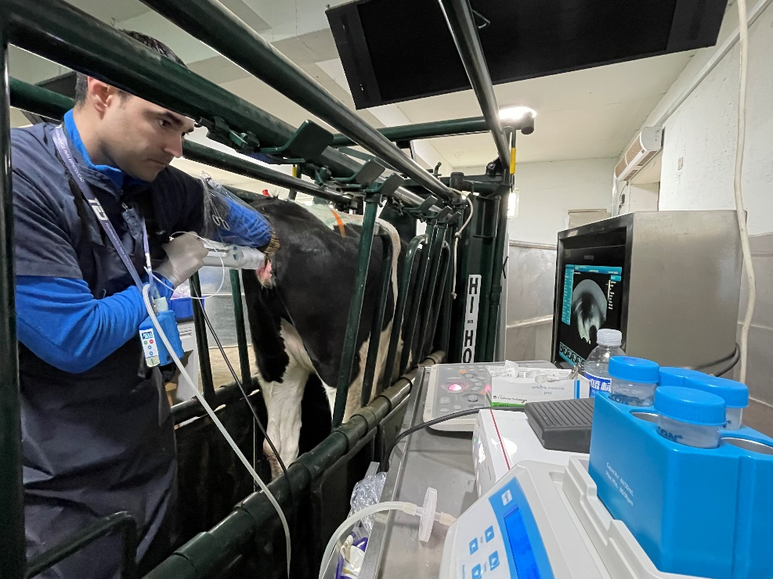
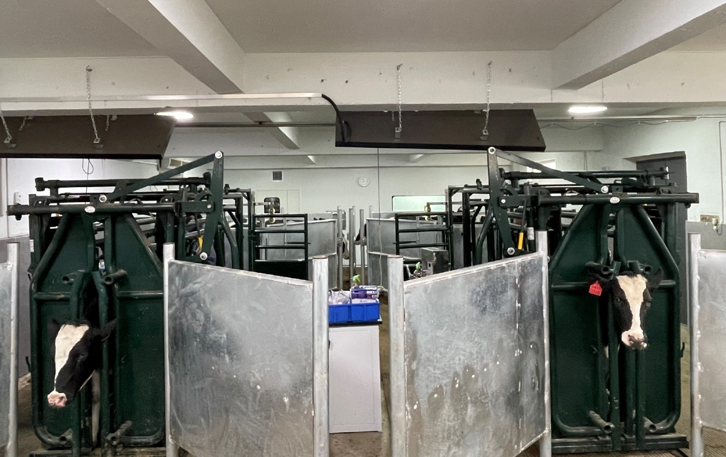
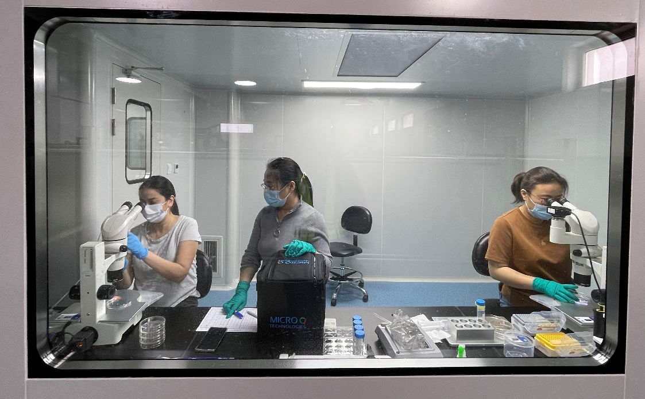
澳亚体外胚胎生产中心—活体采卵间
AustAsia IVP center – OPU labs

Slide 34
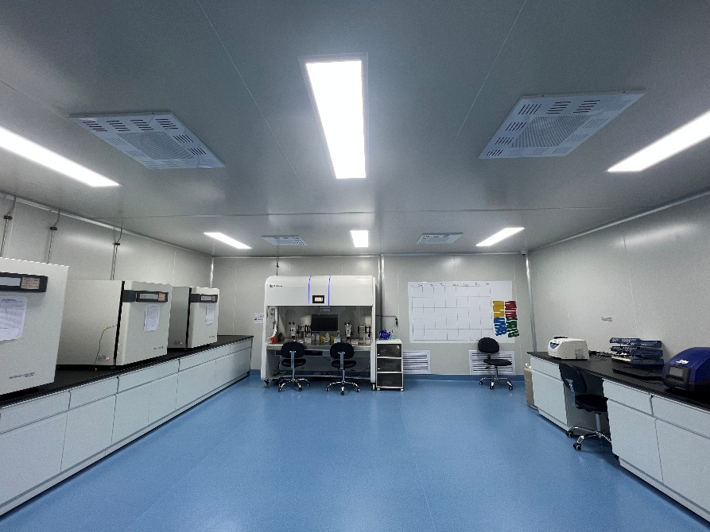
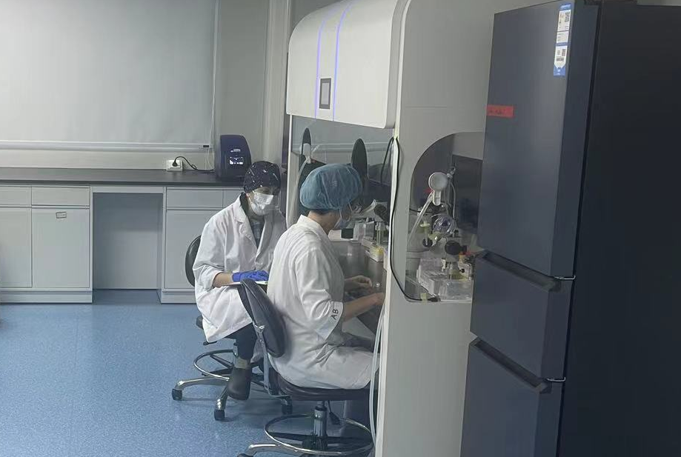
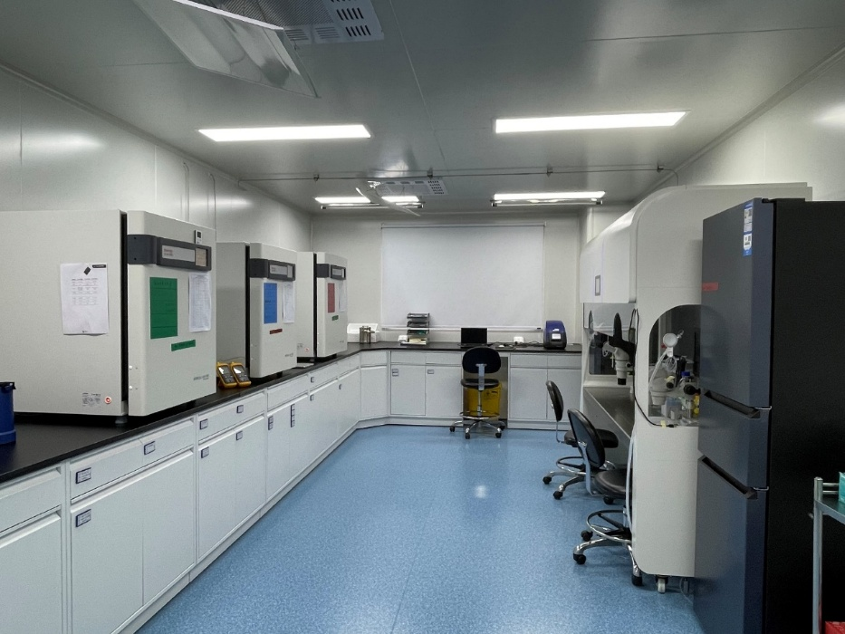
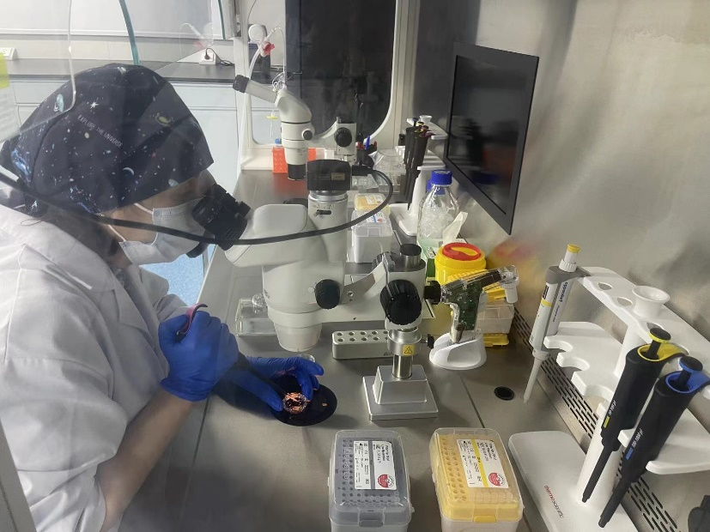
澳亚体外胚胎生产中心—培养实验室
AustAsia IVP center – IVF lab

Slide 35
澳亚体外胚胎生产和移植情况
AustAsia embryo IVP and transfer
 | 2023 | 2024
采卵头次, OPU times | 8240 | 6447
生产胚胎数，枚 Embryo production | 20241 | 19986
平均可用胚胎数，枚 Ave. embryos per OPU | 2.46 | 3.10
出胚率，% Embryo % | 18.12 | 23.2%
移植受胎率 CR | 鲜胚 Fresh | 冻胚 Frozen | 总计 Total
初检受胎率，% CR of 38 days | 57.45% （1114/1939） | 51.20% （5638/11011） | 52.14%（6752/12950）
复检受胎率，% CR of 83 days | 48.89% （948/1939） | 43.78% （4821/11011） | 44.55%（5769/12950）

Slide 36
牛群健康是育种工作的保障
Health is the guarantee of the genetic program
传染病的防控是确保牛群健康的关键
Epidemic diseases control is the key to protect herd health
通过免疫、筛查和净化等措施将传染病管理在可控范围内
Keep epidemic diseases under control with vaccination, screening and purification
疫苗免疫：口蹄疫、梭菌、IBR、BVD、结节性皮肤病
Vaccination: FMD, Clostridium, IBR, BVD, LSD
流产牛筛查：布病、BVD、IBR、钩端螺旋体、犬新孢子虫
Abortion screen: Brucellosis, BVD, IBR, Leptospirosis, Neosporosis
腹泻牛筛查：副结核
Diarrhea screen: Johnes
乳房炎净化：无乳链球菌、金色葡萄球菌、支原体
Mastitis purification: Strep. agalactiae, Staph. aureus, mycoplasma
传染病净化：布病、牛结核、BVD
Epidemic purification: Brocellosis, TB, BVD

Slide 37
小结 Summary
提高21天怀孕率可推动牛群进入生产高效和繁殖高效的良性循环 Improve 21 PR will push the herd into the high production and high fertility cycle
繁育不但是牧场高效运营的发动机，也是增加牧场效益的印钞机 High reproduction is the engine of efficient operation, also is the cash printer of farm profits
遗传物质就是奶牛牧场的新质生产力
Genetics is the new productivity
体外胚胎移植和基因组检测是遗传改良的加速器
IVF ET and genomics are the accelerators of genetic improvement
扩大移植规模，才能为提高选择强度提供基础，用规模抢时间 Expand the ET scales to have more heifers to improve the selection intensity, seize the time with scales
育种让每一个怀孕变得更有意义
Breeding to make every pregnancy more meaningful

Slide 38
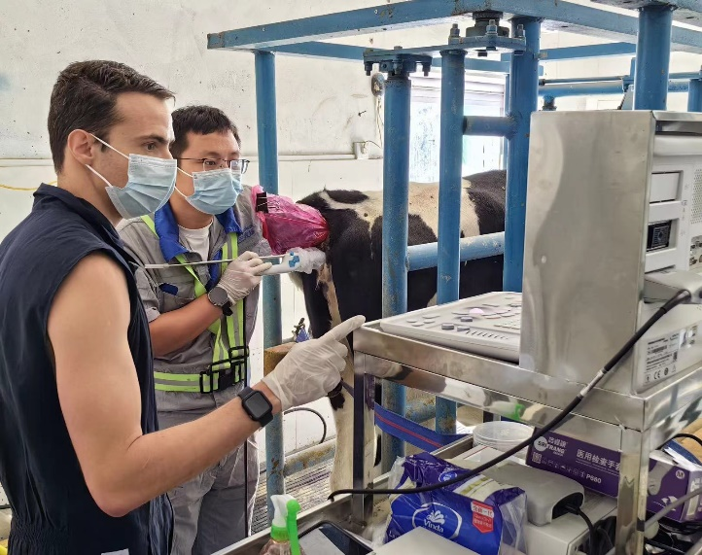
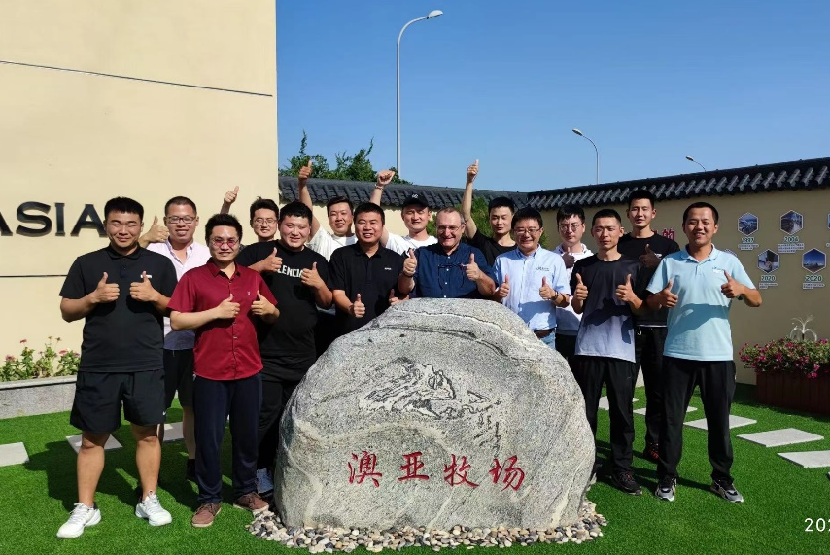
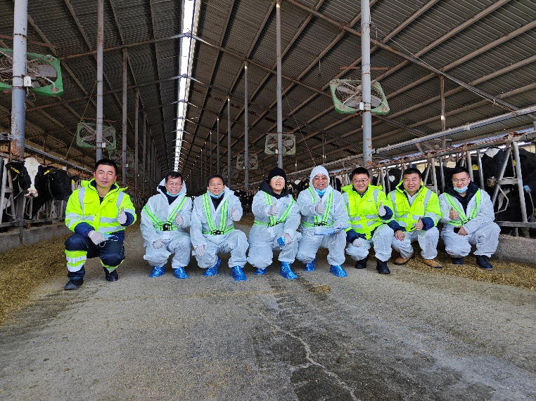
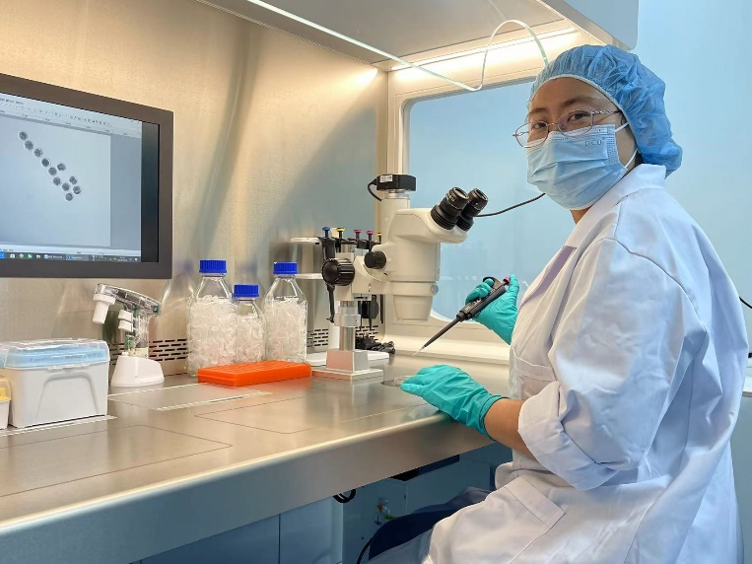
简单、自律、积极进取、良好的心态、健康与安全
Simplify、Self-discipline、Aggressiveness、Positive-attitude、Safety & Health
Our Vision
To become one of the top three dairy farm operators in the world
in terms of operational efficiency and eco-sustainability!

